Slide 1
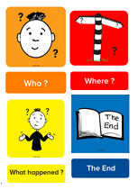

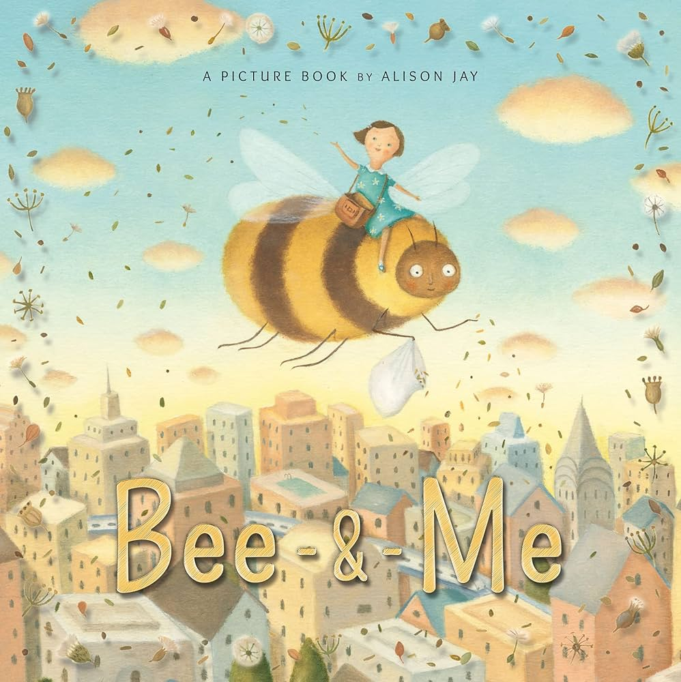


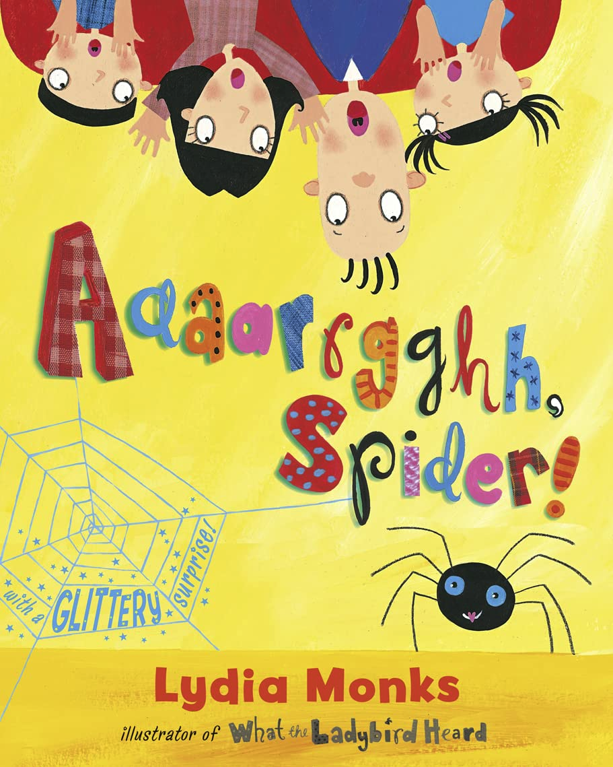

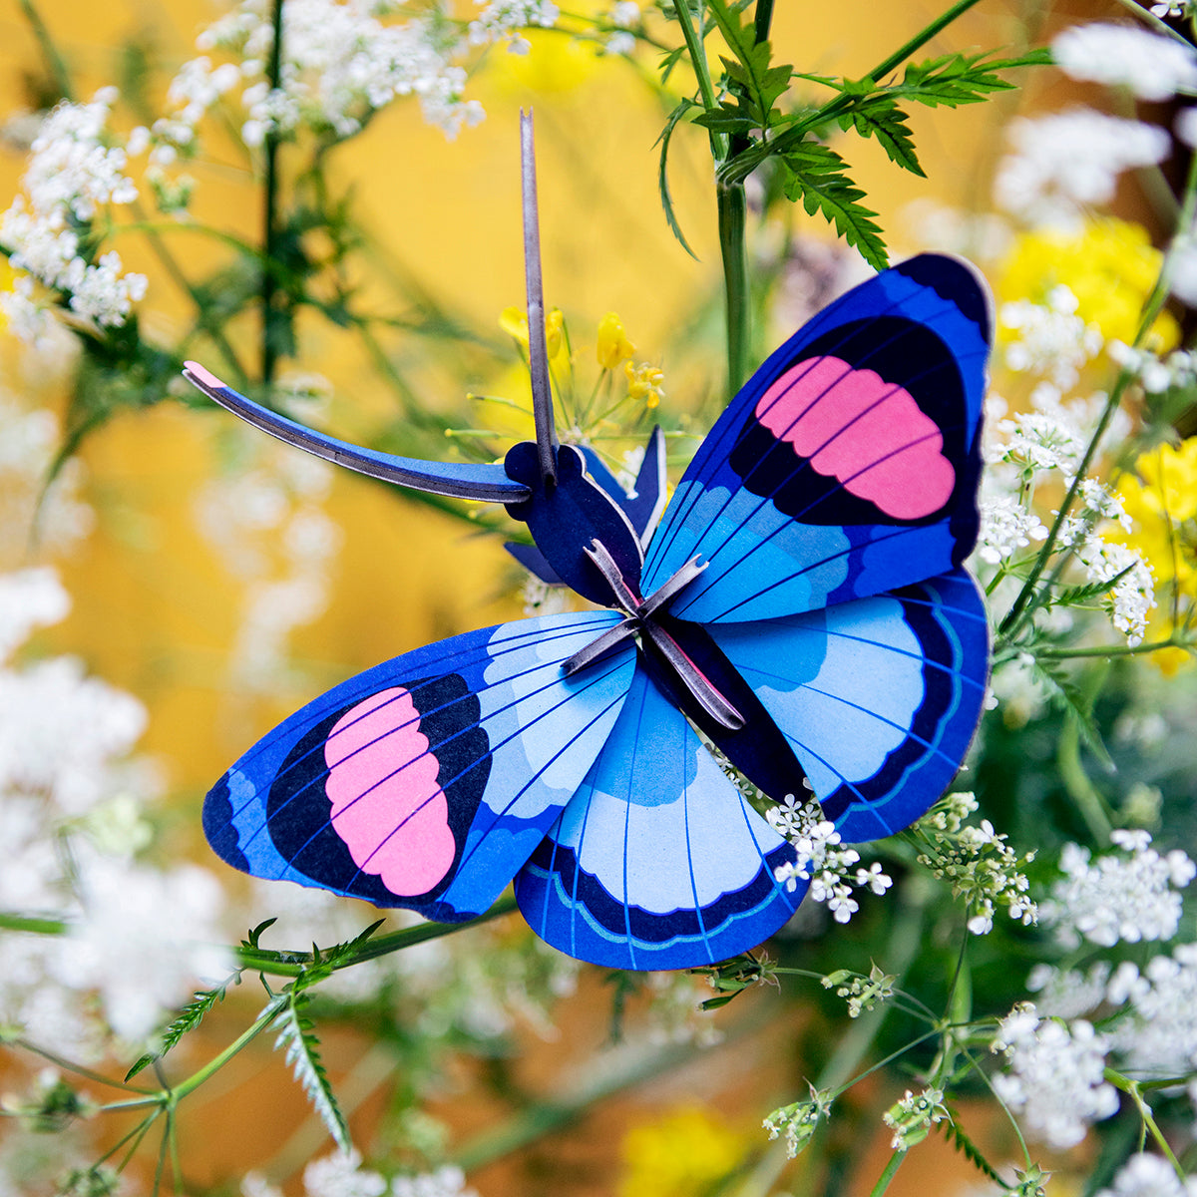
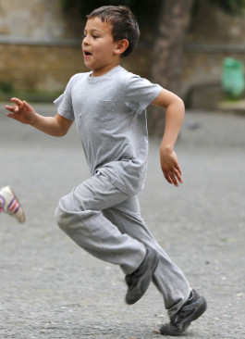
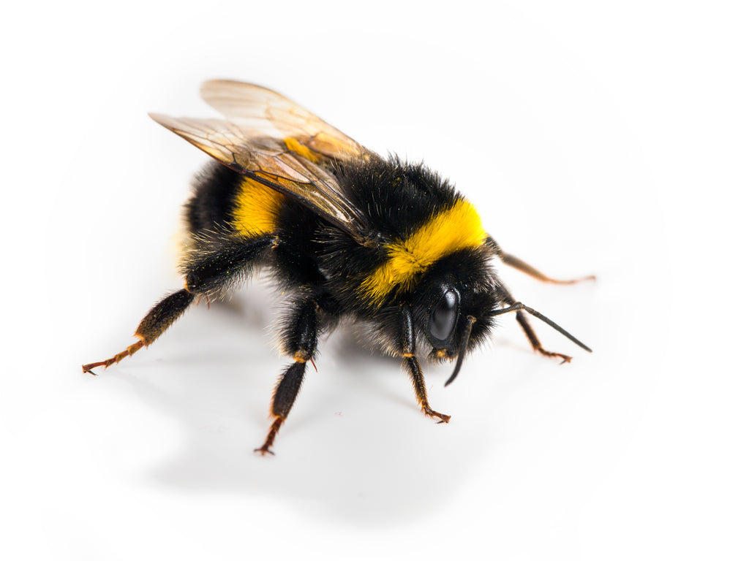
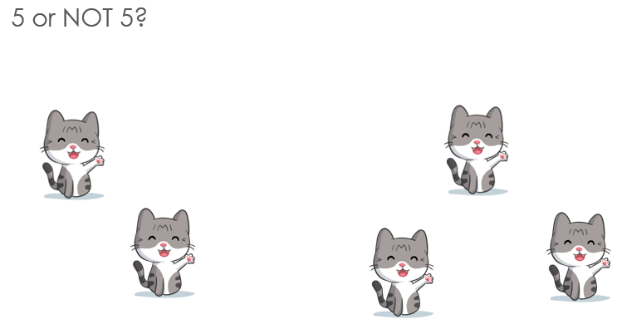

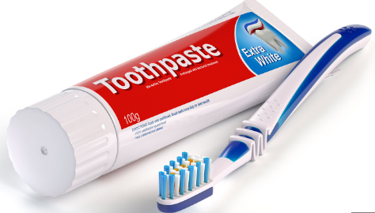
EYFS CURRICULUM MAP: Reception Class, Summer Term 1
Literacy
What are the different parts of a story?
Can you tell a 4-part story? Can you write a 4-part story?
What books do you enjoy reading for pleasure?
Can you recommend a great story book to a friend?
Communication and Language
What is a minibeast?
Where do minibeasts live?
How can we help minibeasts?
Garden Adventures
We can learn about the world and how to care for it and each other.
Physical Development
How can we show the same movements
fast and slow? Which animals move fast / slow?
How can we be safe when taking part in
running and chasing games?
Understanding the World
What is a minibeast?
Where does it live?
What does it eat?
How does it move?
What is the lifecycle?
How can we help take care of bugs we find?
Mathematics
What patterns do you notice?
How many different ways can we make numbers to 10?
Can you compare the 2 groups?
Which shapes have you used to make your picture?
Personal, Social & Emotional Development
What does it mean to be Courageous?
How can I keep my mind and body healthy?
Who can I speak to if I feel worried?
Expressive Arts and Design
Who was Henri Matisse?
How did he create his artwork?
If you could ask Matisse one question what would it be?

